Slide 1
Using Jars

Slide 2
Using Jar Files
Up until now we've been creating a runnable jar file that contains 'main' and allows us to run our app independent of the IDE
Typically we want to re-use functionality from other codebases, ex.
unit testing – junit
logging – log4j2
commandline processing – apache commons cli

Slide 3
Example: Apache Commons CLI
The Apache Commons CLI library is an open source library that provides an API for parsing command line options passed to your program
Commons CLI supports different types of options:
POSIX like options (ie. tar -zxvf foo.tar.gz)
GNU like long options (ie. du --human-readable --max-depth=1)
Java like properties (ie. java -Djava.awt.headless=true -Djava.net.useSystemProxies=true Foo)
Short options with value attached (ie. gcc -O2 foo.c)
long options with single hyphen (ie. ant -projecthelp)

Slide 4
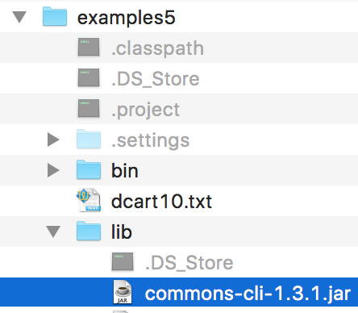
Setup
First find and download the library you want to use
http://commons.apache.org/proper/commons-cli/download_cli.cgi
Although you can create a common location for all your external (or third-party) libraries, for simplicity we'll create a lib folder and put the commons-cli-1.3.1.jar file there

Slide 5
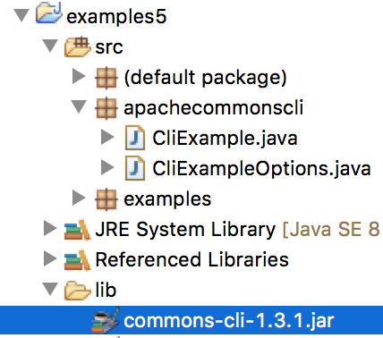
eclipse
Import the project – if it already exists in eclipse then refresh
To make the jar file visible to the compiler, you must add it to the classpath
Right-click the jar file > Build Path > Add to build path

Slide 6
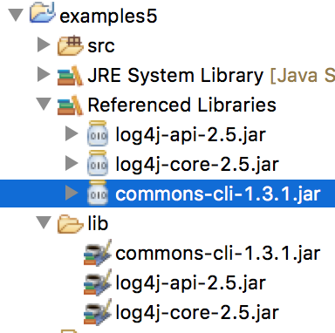
Using the jar file
Now that the jar file is in your build path, you can use the classes the same as using any java library classes
See CliExample
Note – for assignment 1, you can make use of Apache Common CLI, if you do then each of the commandline arguments will be preceded with a dash ('-')
CliExample

